Slide 1

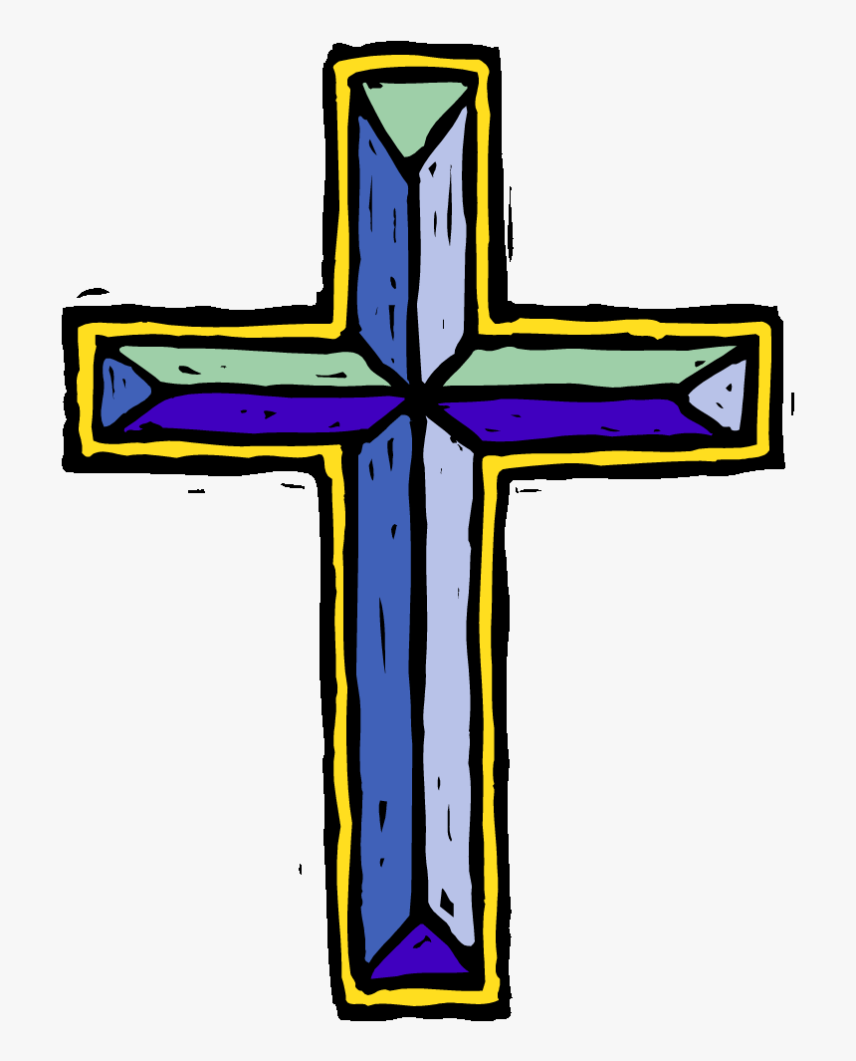
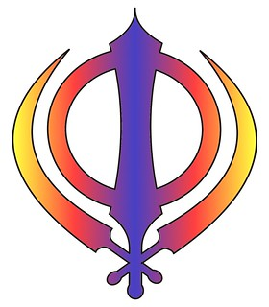

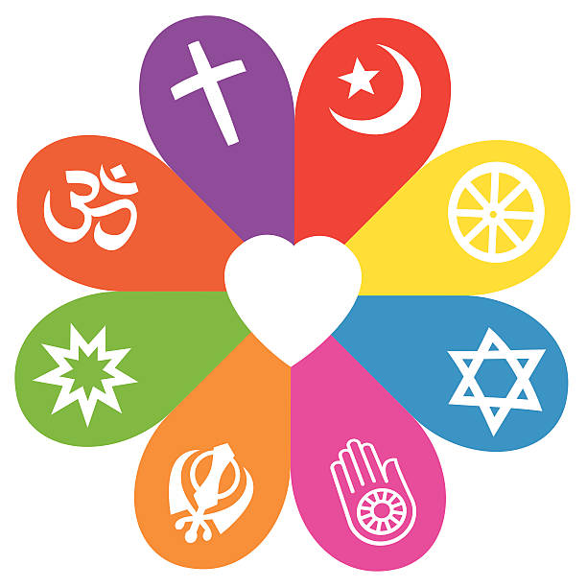
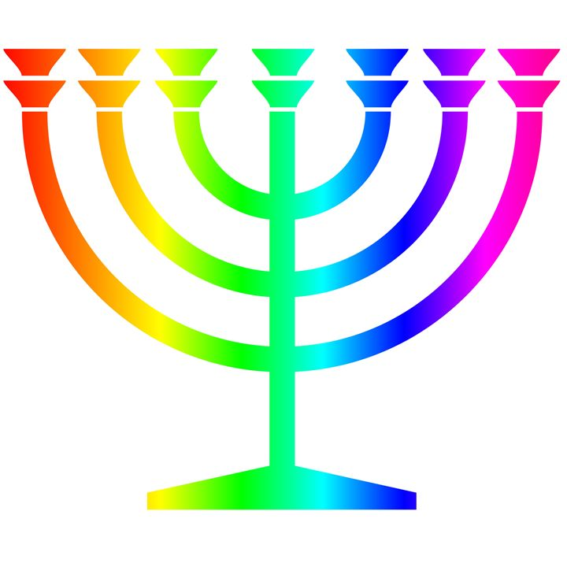

Autumn
What do Christians learn from the creation story?
Christians believe God the Creator cares for the creation, including human beings.
Christians believe that as human beings are part of God’s good creation, they do best when they listen to God.
Christians believe that The Bible shows that God wants to help people to be close to him — he keeps his relationship with them, gives them guidelines on good ways to live (such as the Ten Commandments)
What is the Trinity?
Christians believe God is Trinity: Father, Son and Holy Spirit.
Christians believe The Father creates; he sends the Son who saves his people; the Son sends the Holy Spirit to his followers.
Christians find that understanding God is challenging; people spend their whole lives learning more and more about God.
Christians really want to try to understand God better and so try to describe God using symbols, similes and metaphors, in song, story, poems and art.
Christians worship God as Trinity. It is a huge idea to grasp and Christians have created art to help to express this belief.
Christians believe the Holy Spirit is God’s power at work in the world and in their lives today, enabling them to follow Jesus.
RE Learning Journey Year 3
Spring
What is it like to follow God?
The Old Testament tells the story of a particular group of people, the children of Israel known as the People of God — and their relationship with God.
The People of God try to live in the way God wants, following his commands and worshipping him.
They believe he promises to stay with them and Bible stories show how God keeps his promises.
Why do Christians call the day Jesus died Good Friday?
Christians see Holy Week as the culmination of Jesus’ earthly life, leading to his death and resurrection.
The various events of Holy Week, such as the Last Supper, were important in showing the disciples what Jesus came to earth to do.
Christians today trust that Jesus really did rise from the dead, and so is still alive today.
Christians remember and celebrate Jesus’ last week, death and resurrection
Understanding Christianity
Non-Christian faith
Comparing beliefs and practices
Summer
What does it mean to be a Sikh in Britain today?
That the Moor Mantar is an important text for Sikhs and that it talks of one God, equality and service.
About the life of Guru Nanak ( and other Gurus) and that service, human equality and dignity are important to Sikhs.
About the Guru Granth Sahib – how it is treated and learnt from.
About what matters most to the Sikh community – Khalsa, Sikh symbols, the five K’s, the gurdwara, langar and serving others.
About key Sikh values: remembering God; working hard and honestly; sharing with other people.
About a significant Sikh festival. E.g. Vaisakhi or Guru Nanak’s birthday.

