Slide 1
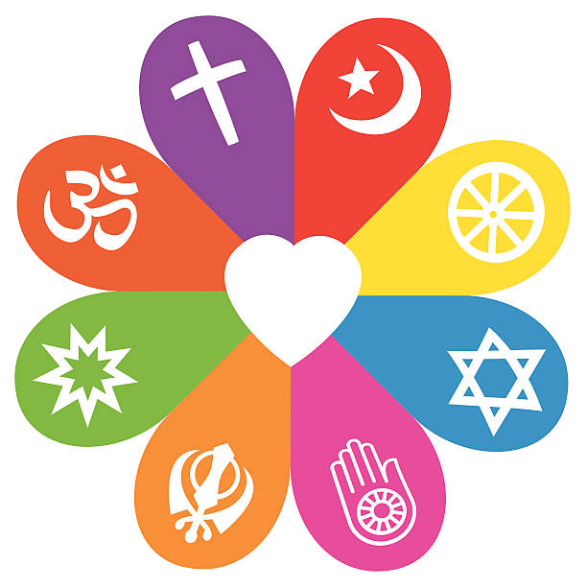
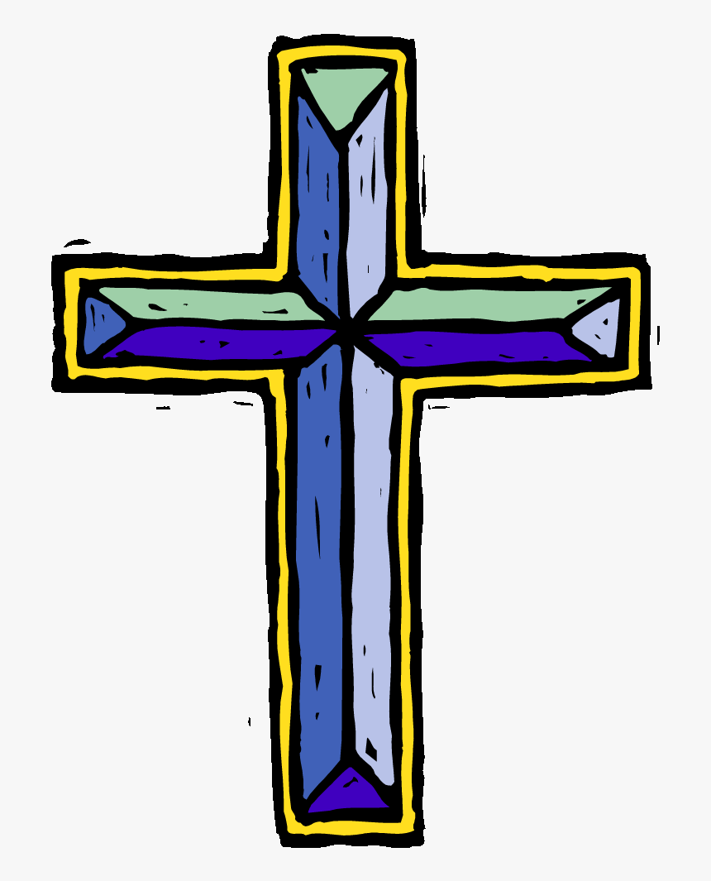
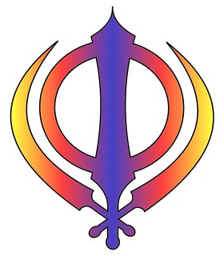
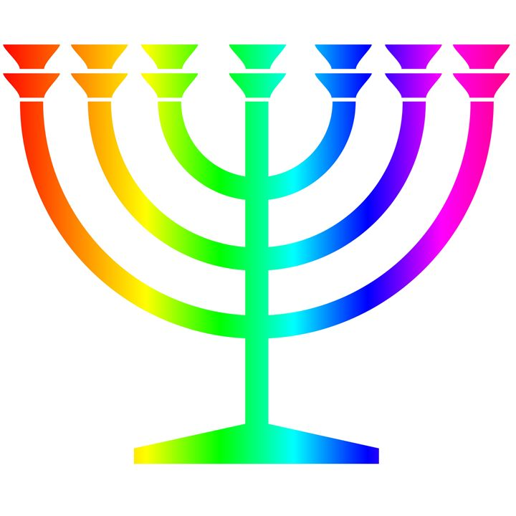
Autumn
Why is the word God so important to Christians?
The word God is a name.
Christians believe God is the creator of the universe.
Christians believe God made our wonderful world and so we should look after it.
Why do Christians perform nativity plays at Christmas?
Christians believe God came to Earth in human form as Jesus.
Christians believe Jesus came to show that all people are precious and special to God.
RE Learning Journey Reception
Spring
Being special: where do we belong?
Retell religious stories, making connections with personal experiences
Share and record occasions when things have happened in their lives that made them feel special
Recall simply what happens at a traditional Christian infant baptism and dedication
Recall simply what happens when a baby is welcomed into a religion other than Christianity
Why do Christians put a cross in an Easter garden?
Easter is very important in the ‘big story’ of the Bible.
Jesus showed that he was willing to forgive all people, even for putting him on the cross.
Christians believe Jesus builds a bridge between God and humans.
Christians believe Jesus rose from the dead, giving people hope of a new life.
Understanding Christianity
Non-Christian faith
Comparing beliefs and practices
Summer
Which places are special and why?
Talk about somewhere that is special to themselves, saying why
Recognise that some religious people have places which have special meaning for them
Talk about the things that are special and valued in a place of worship
Identify some significant features of sacred places
Recognise a place of worship
Get to know and use appropriate words to talk about their thoughts and feelings when visiting a church
Express a personal response to the natural world.
Which stories are special and why?
Talk about some religious stories
Recognise some religious vocabulary, e.g. about God
Identify some of their own feelings in the stories they hear
Identify a sacred text e.g. Bible, Qur’an
Talk about what Jesus teaches about keeping promises and say why keeping promises is a good thing to do
Talk about what Jesus teaches about saying ‘thank you’, and why it is good to thank and be thanked.

